Slide 1
PCR
PUBLIC COMPLAINT RESOLVER
Enter Your Complaint
U19CS505-SOFTWARE DEVELOPMENT LABORATORY
1

Slide 2
Problem Statement
The existing complaint processing system (through digital application) by government officials for public in terms of registration and track of complaint process and receiving the acknowledgement for problem solved but there is possibilities of faux acknowledgement which is not known to the public .
A solution is required to develop to enable controlling of acknowledgement should be given to the public with feature of verification request
$62,000
Get a modern PowerPoint Presentation that is beautifully designed. I hope and I believe that this Template will your Time, Money and Reputation.
PCR
2
DELIVER PROGRESS REPORT

Slide 3
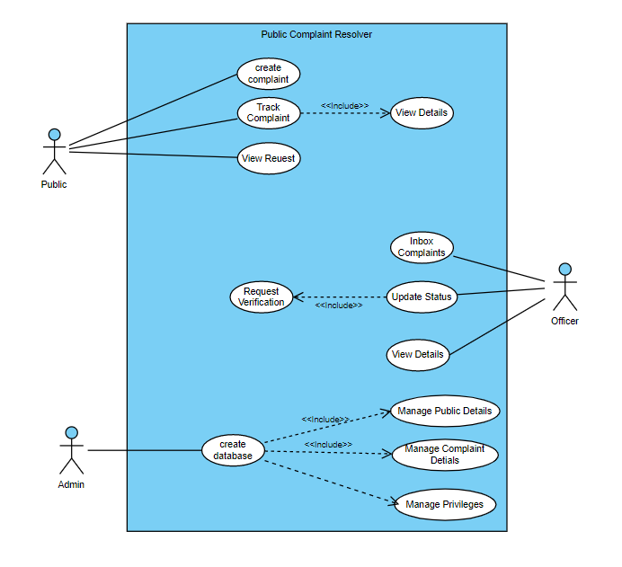
USECASE DIAGRAM
3

Slide 4
UML CLASS DIAGRAM
Class name : officer
name : int govt_id : int dob : date aadhar_no : long zone : string role : string
set_info() get_info() Change_info() request_verify()
Class name : complaint
complaint_id : int name : String pub_user : int details : string zone : string type : String
new_complaint() track_complaint() get_details() delete_complaint() search_complaint()
Class name : login
name : string password : int role : string
Verify_data() create_pub prof() create_off_prof()
Class name : people
name : int random_Id : int dob : date aadhar_no : long address : string pincode : int
set_info() get_info() Change_info() Verify_complaint() redirect()
4

Slide 5
INTERACTION DIAGRAM (SEQUENCE DIAGRAM)
Firebase Authentication
System
Officer
Public
login
Success
Register Complaint
Verify &
Send
Verify &
Send
Processing Complaint
Verifying Completion
Tracking Complaint
Exit
5

Slide 6
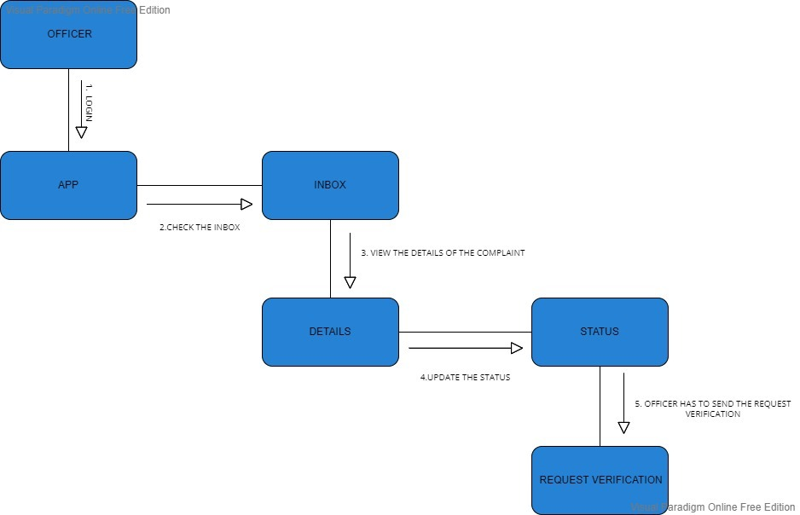
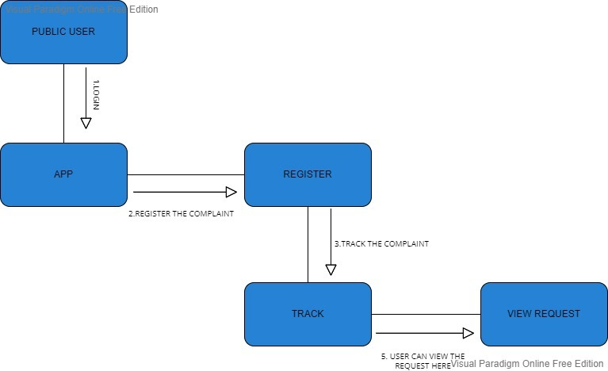
INTERACTION DIAGRAM (COLLABORATION DIAGRAM)
6

Slide 7
MODULES
Option View
Officer
Public
Inbox Complaint
Signup
Login
Update Status
Create complaint
Track Complaint
View Details
Raised Complaint
Request Verification Sent
View Requests
7

Slide 8
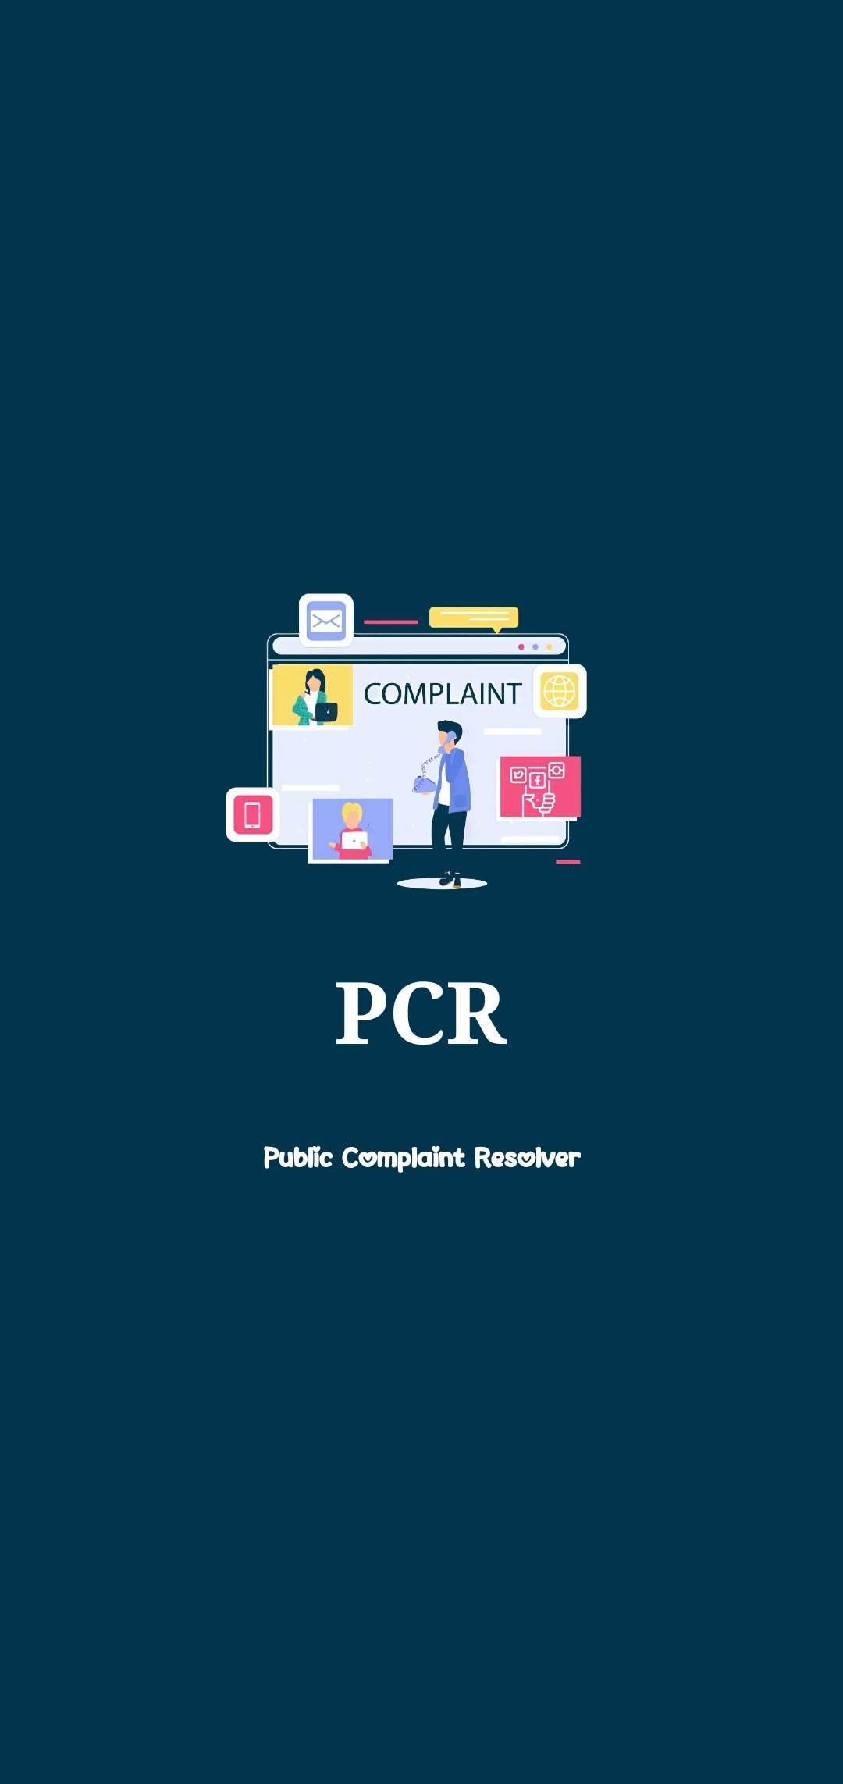
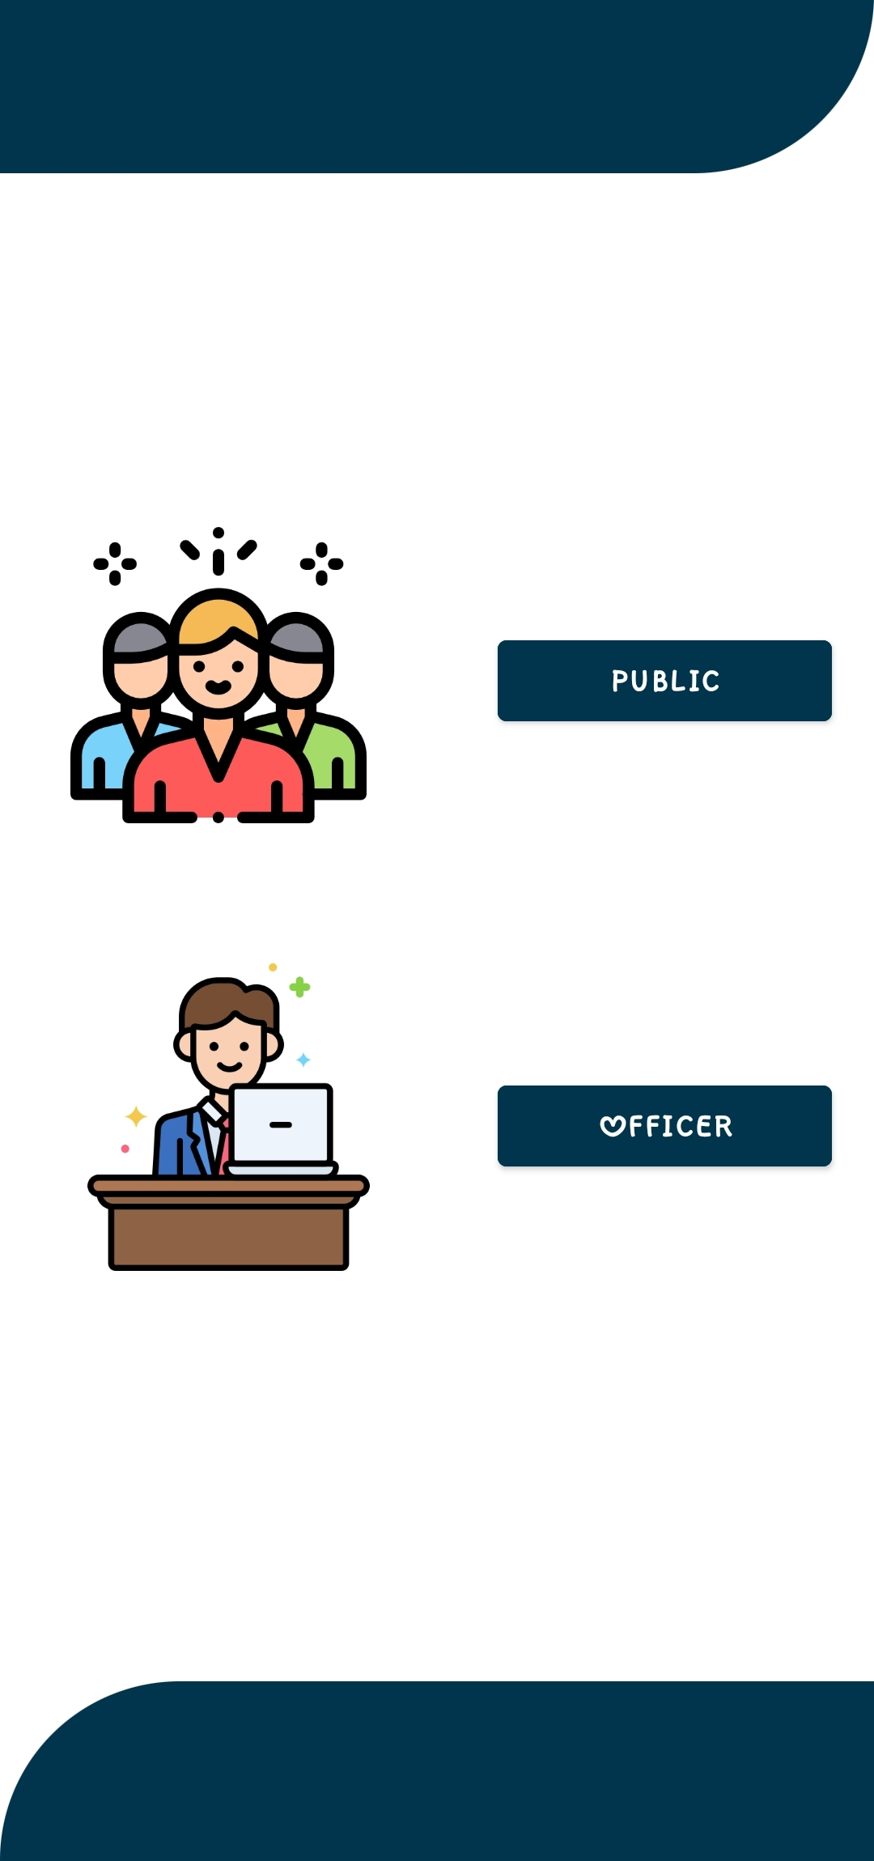
OPTION VIEW
8

Slide 9
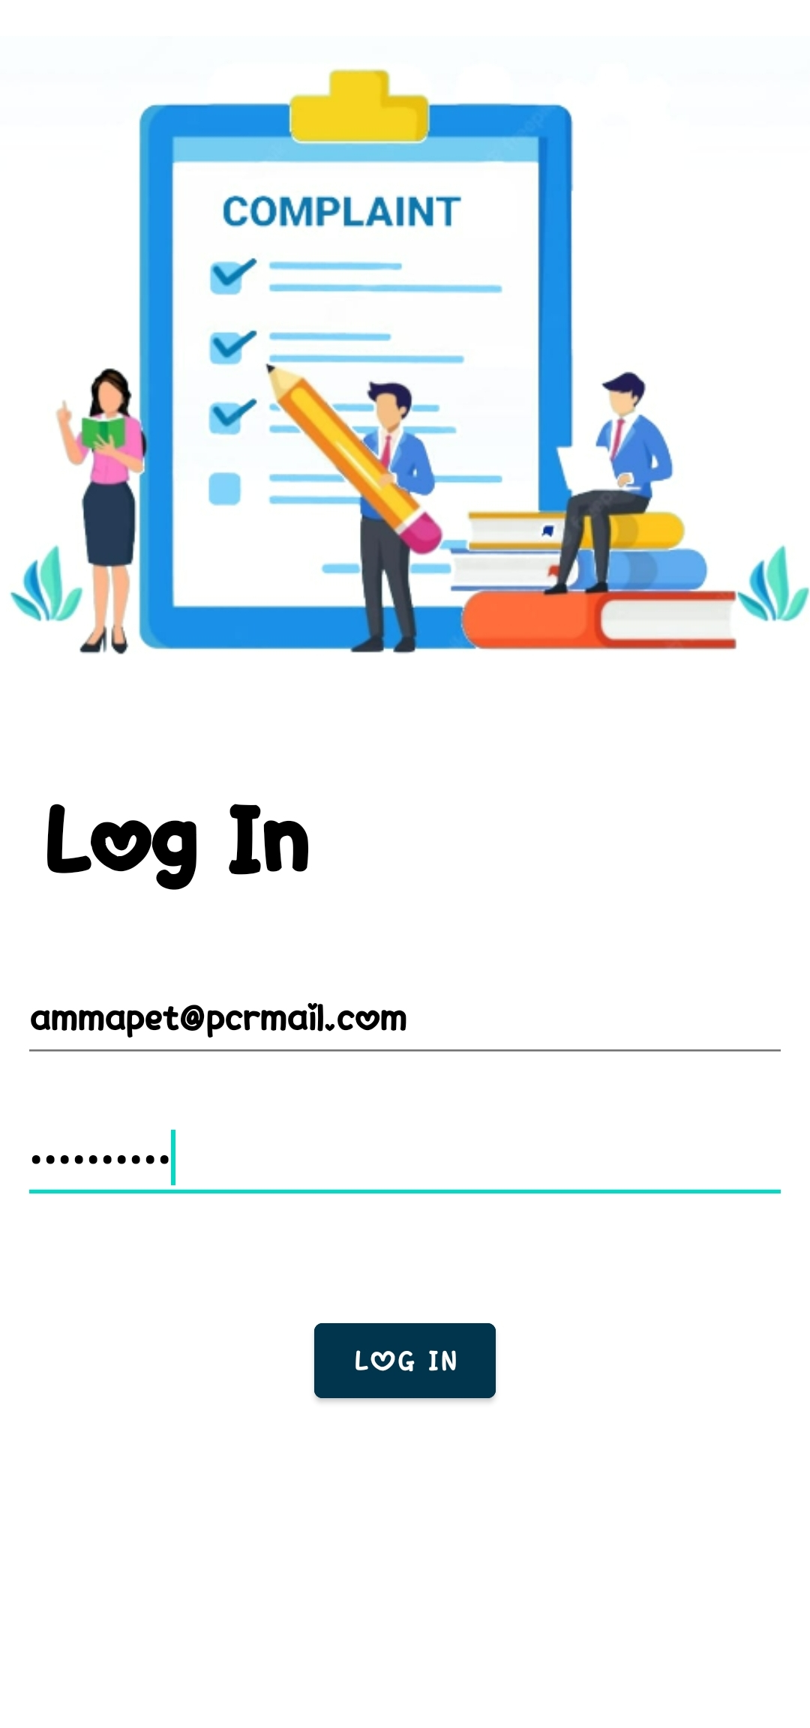
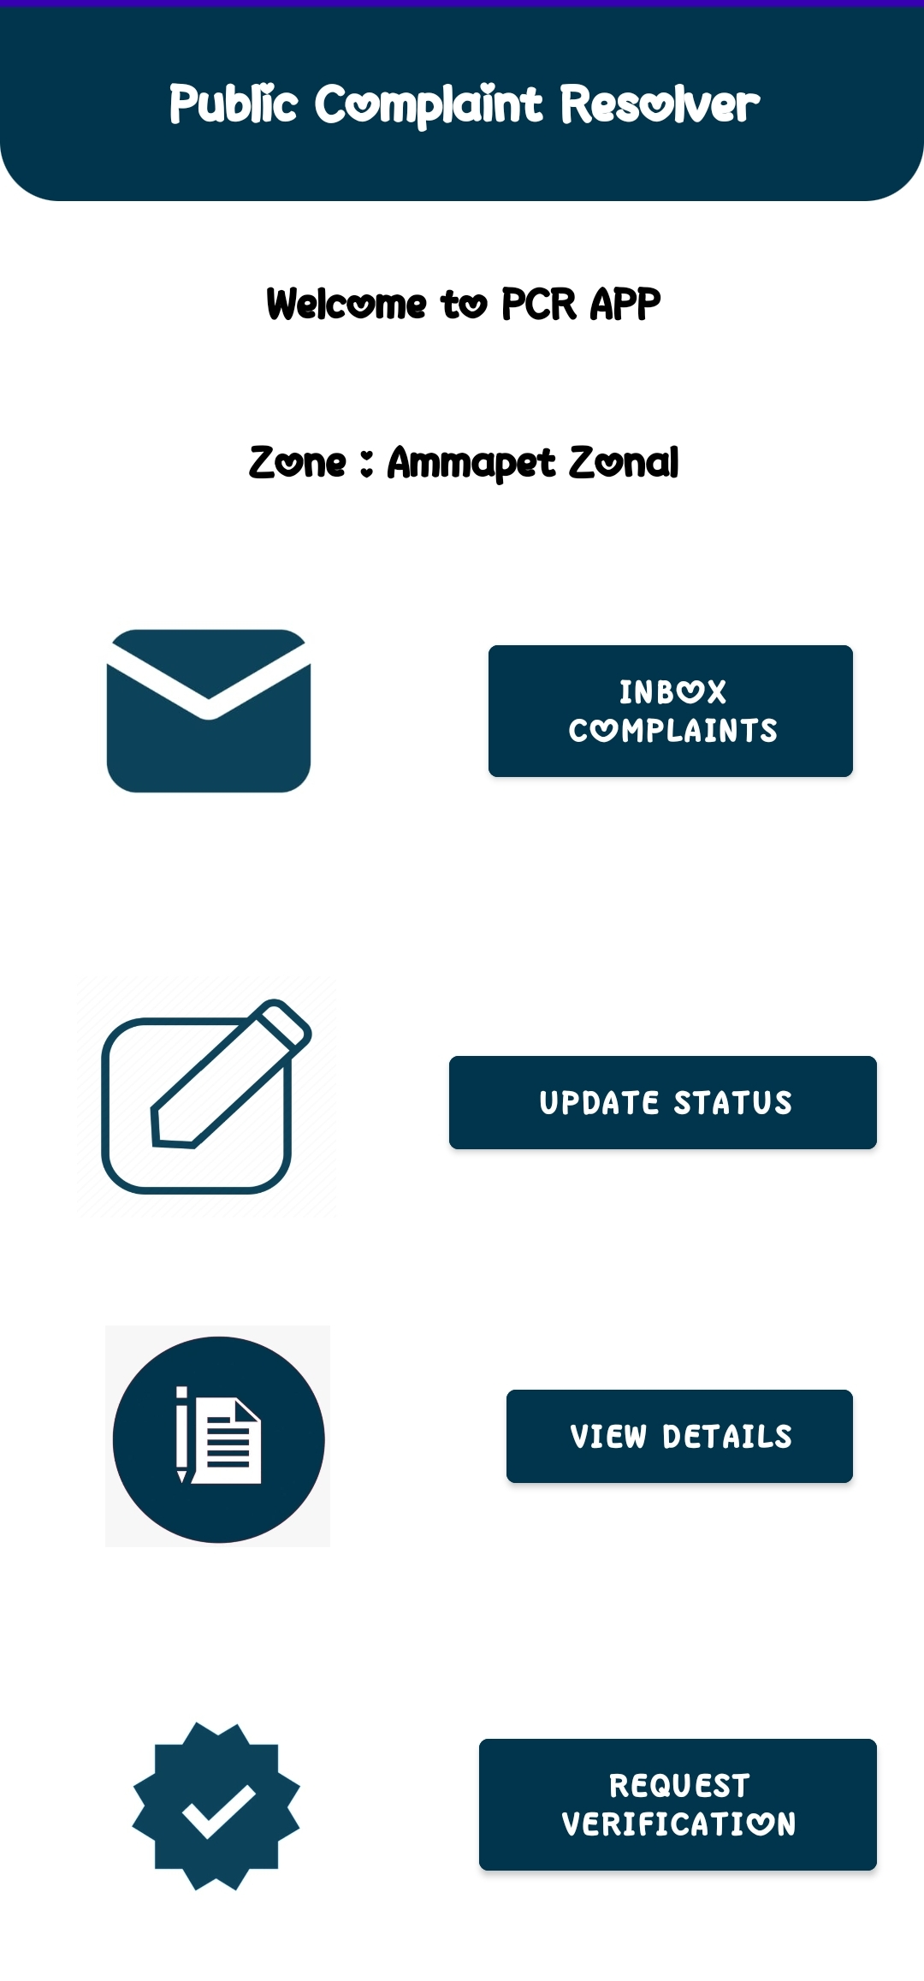
OFFICER (LOG IN)
<<login>>
<<officer>>
9

Slide 10
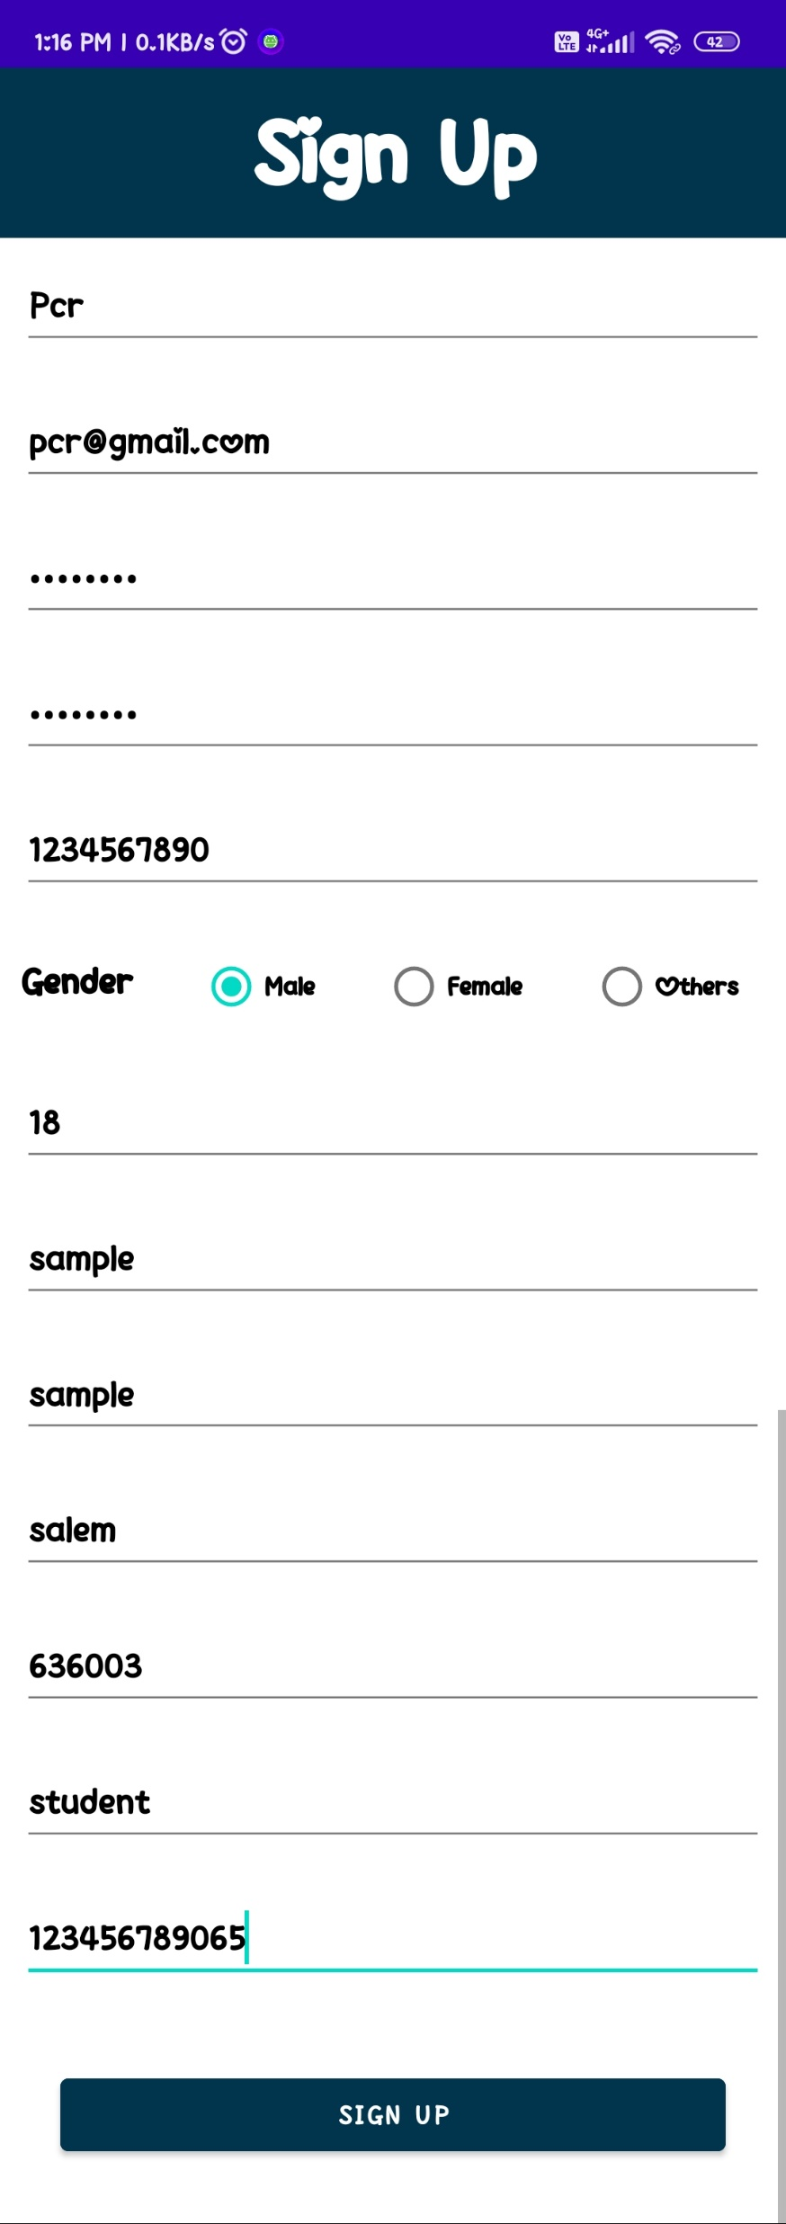
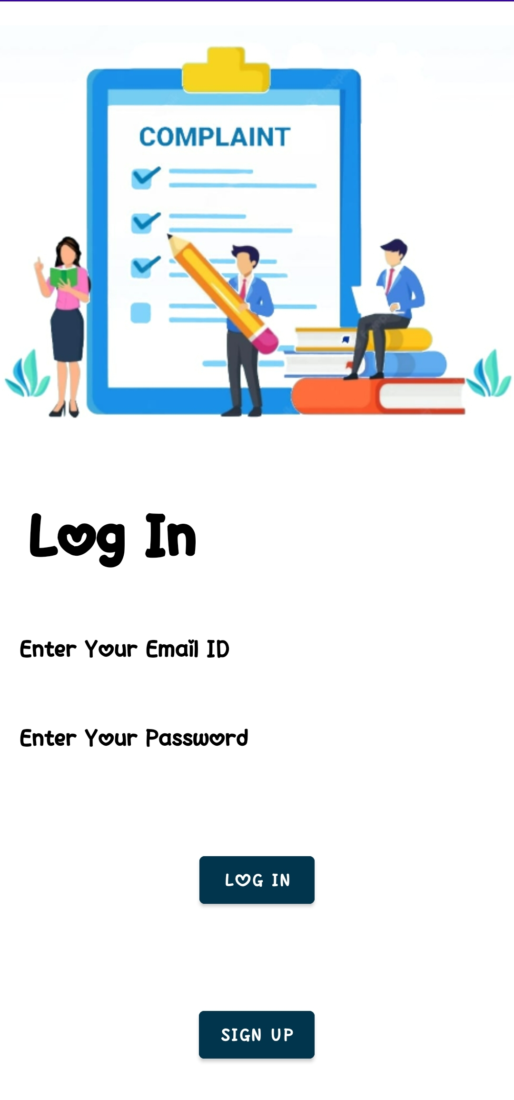
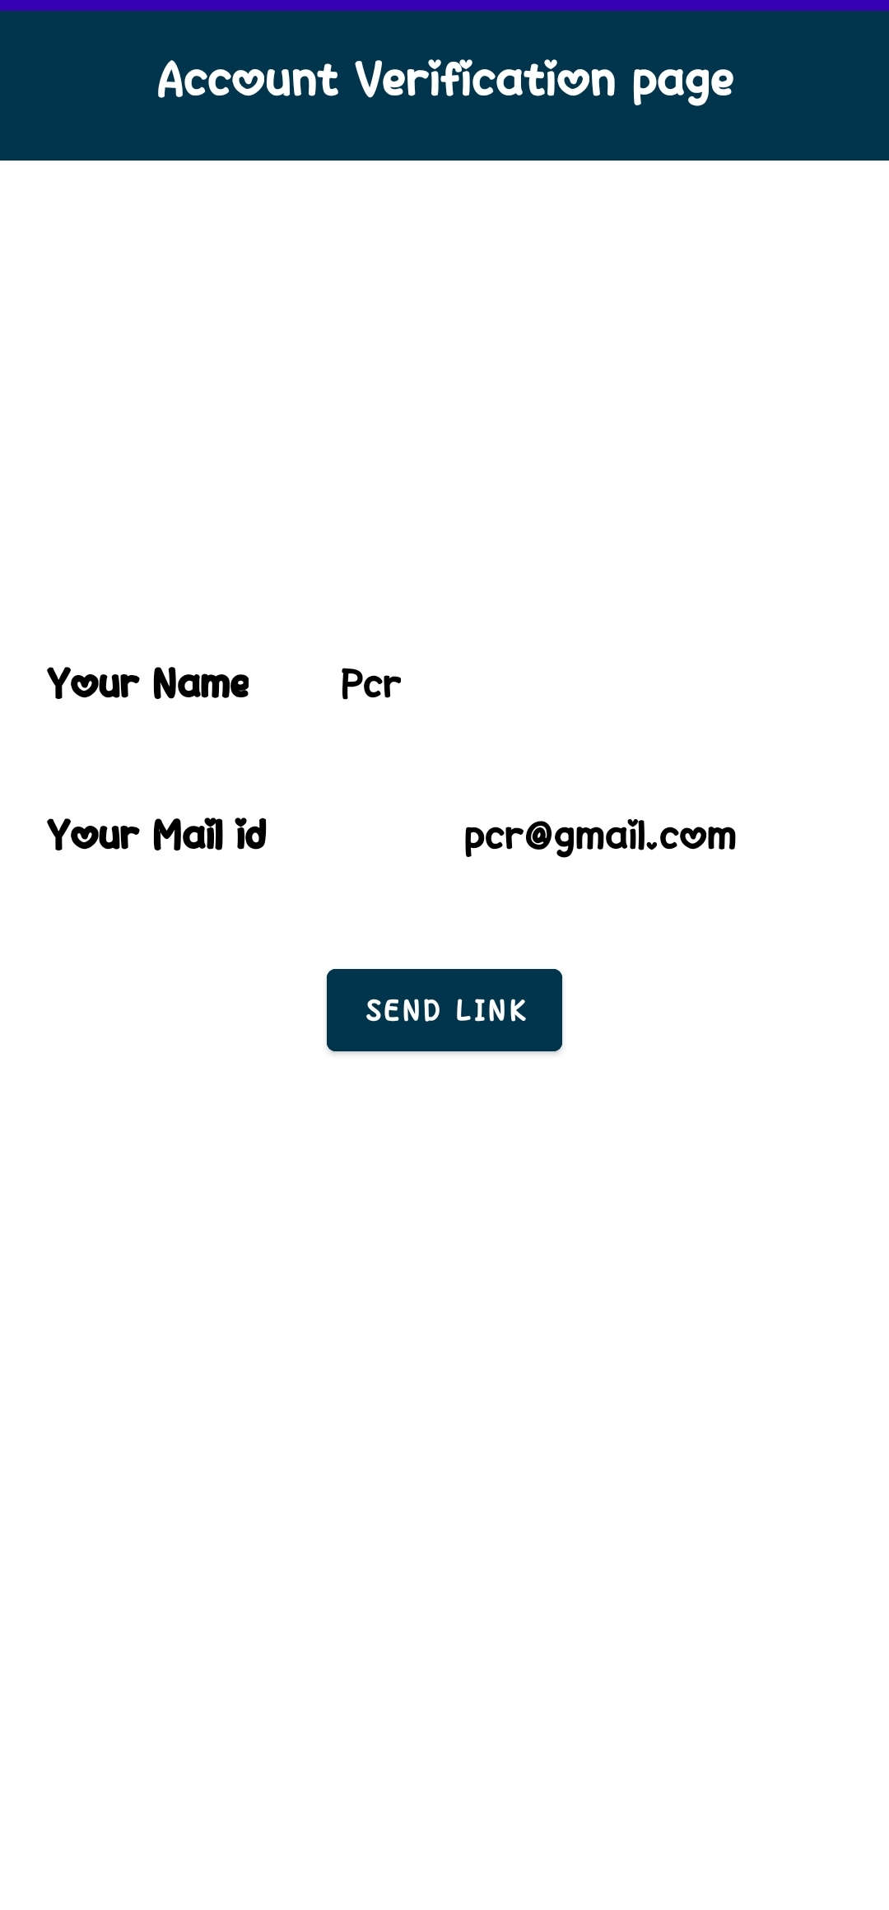
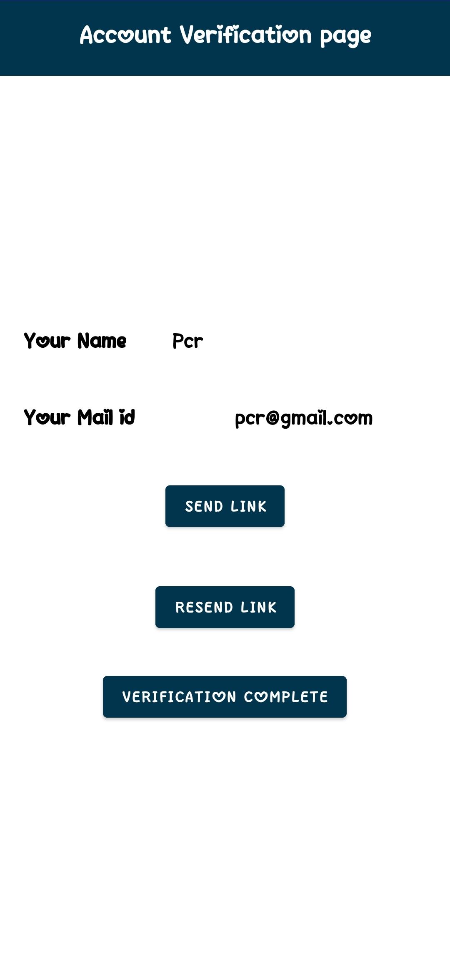
PUBLIC (SIGN UP)
<<signup>>
<<send-link>>
<<signup>>
10

Slide 11
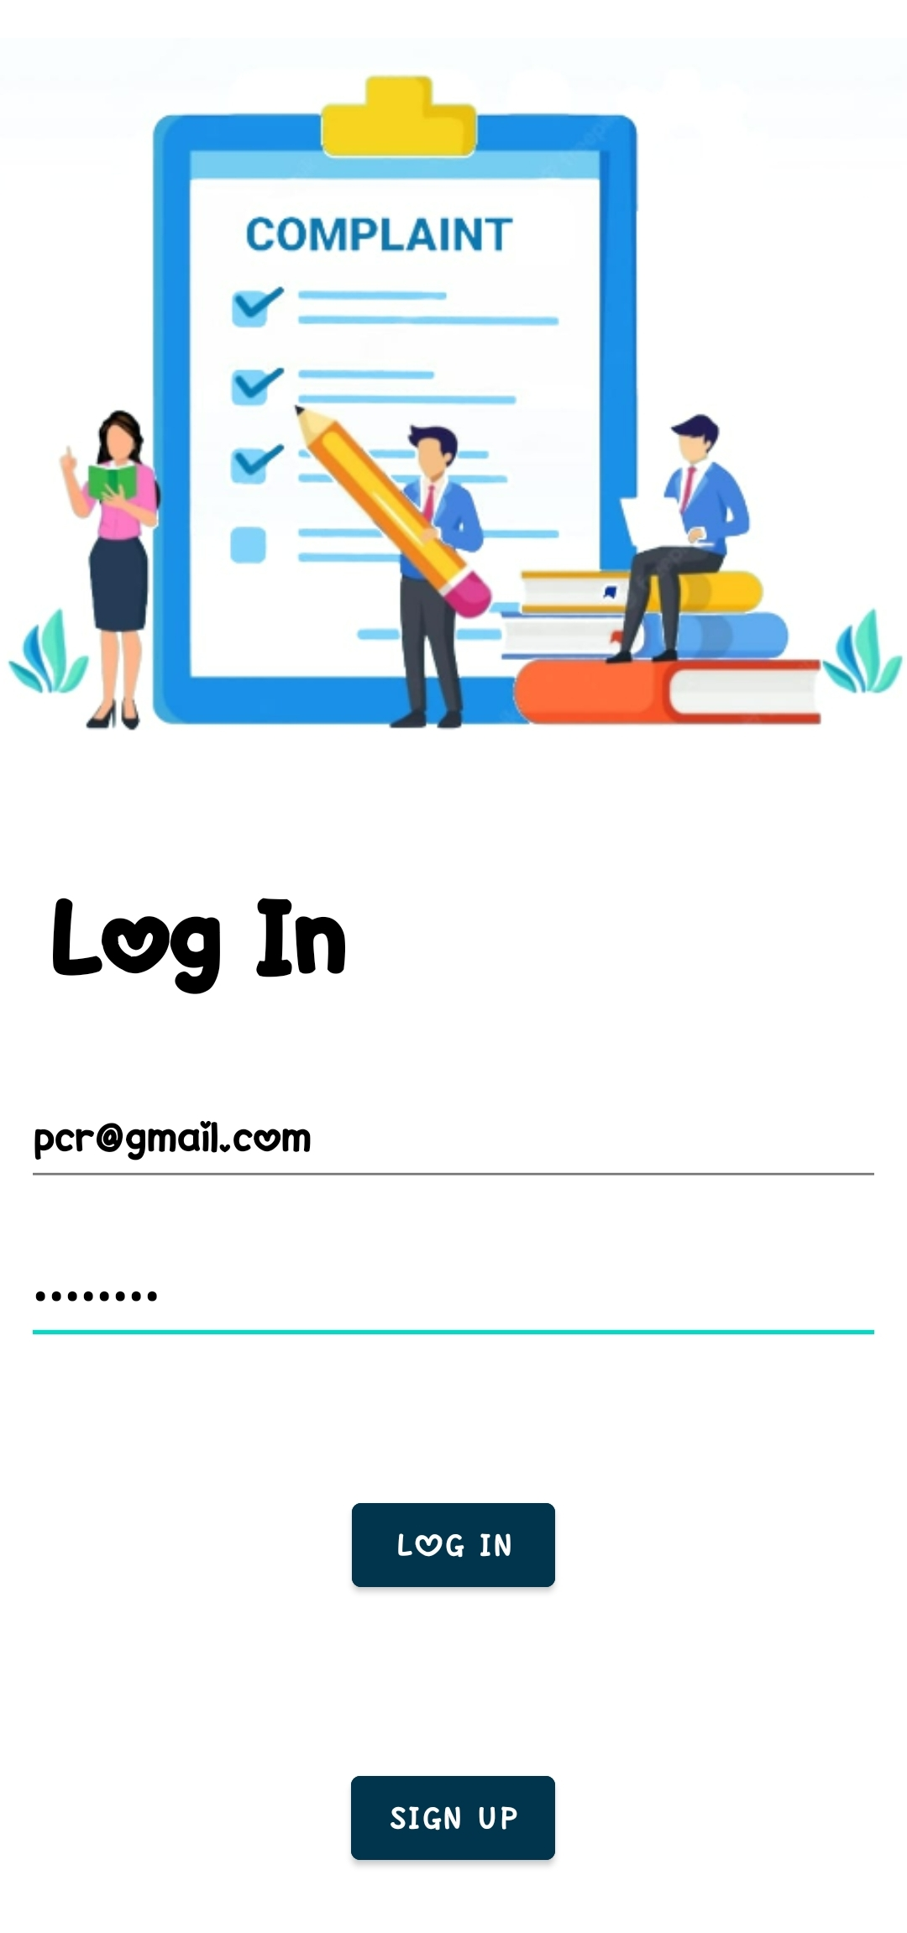
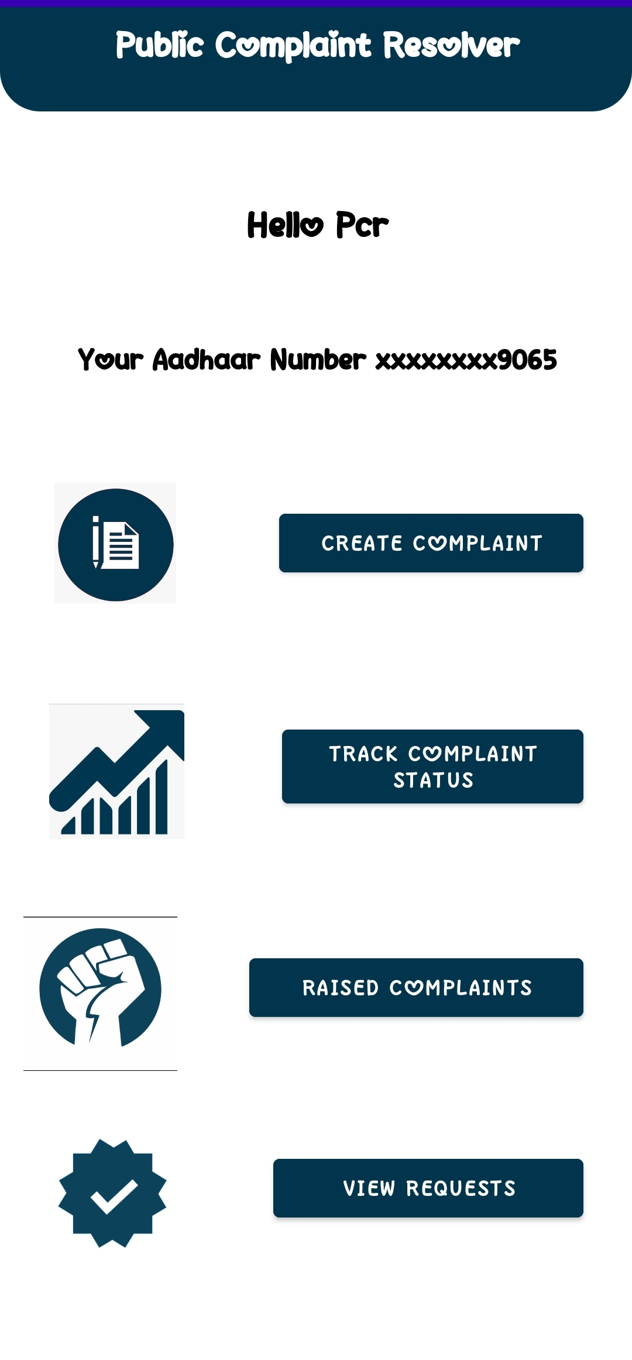
PUBLIC (LOG IN)
<<public>>
<<login>>
11

Slide 12
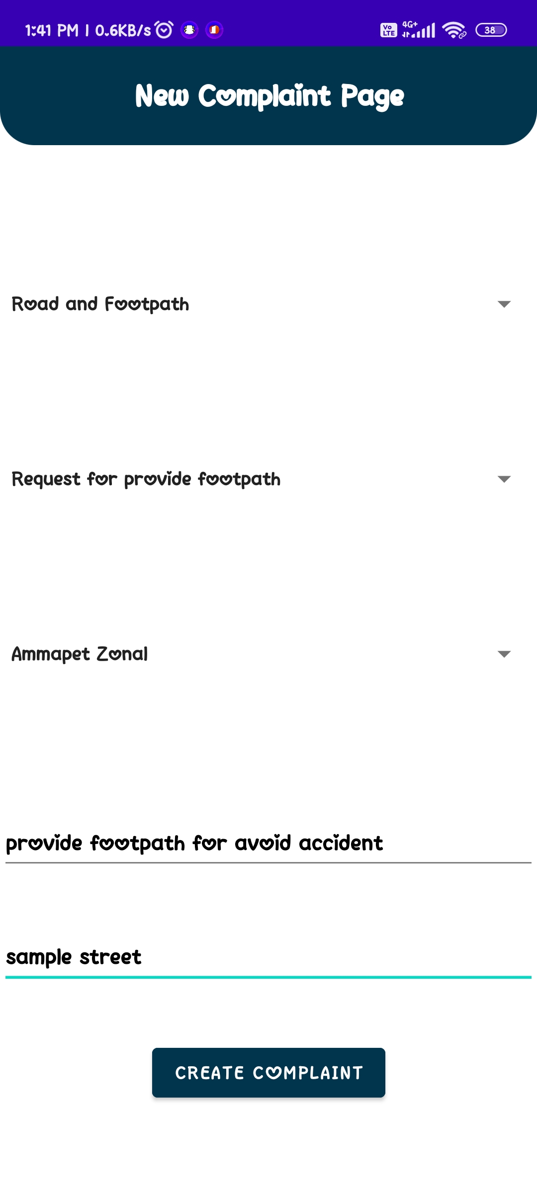
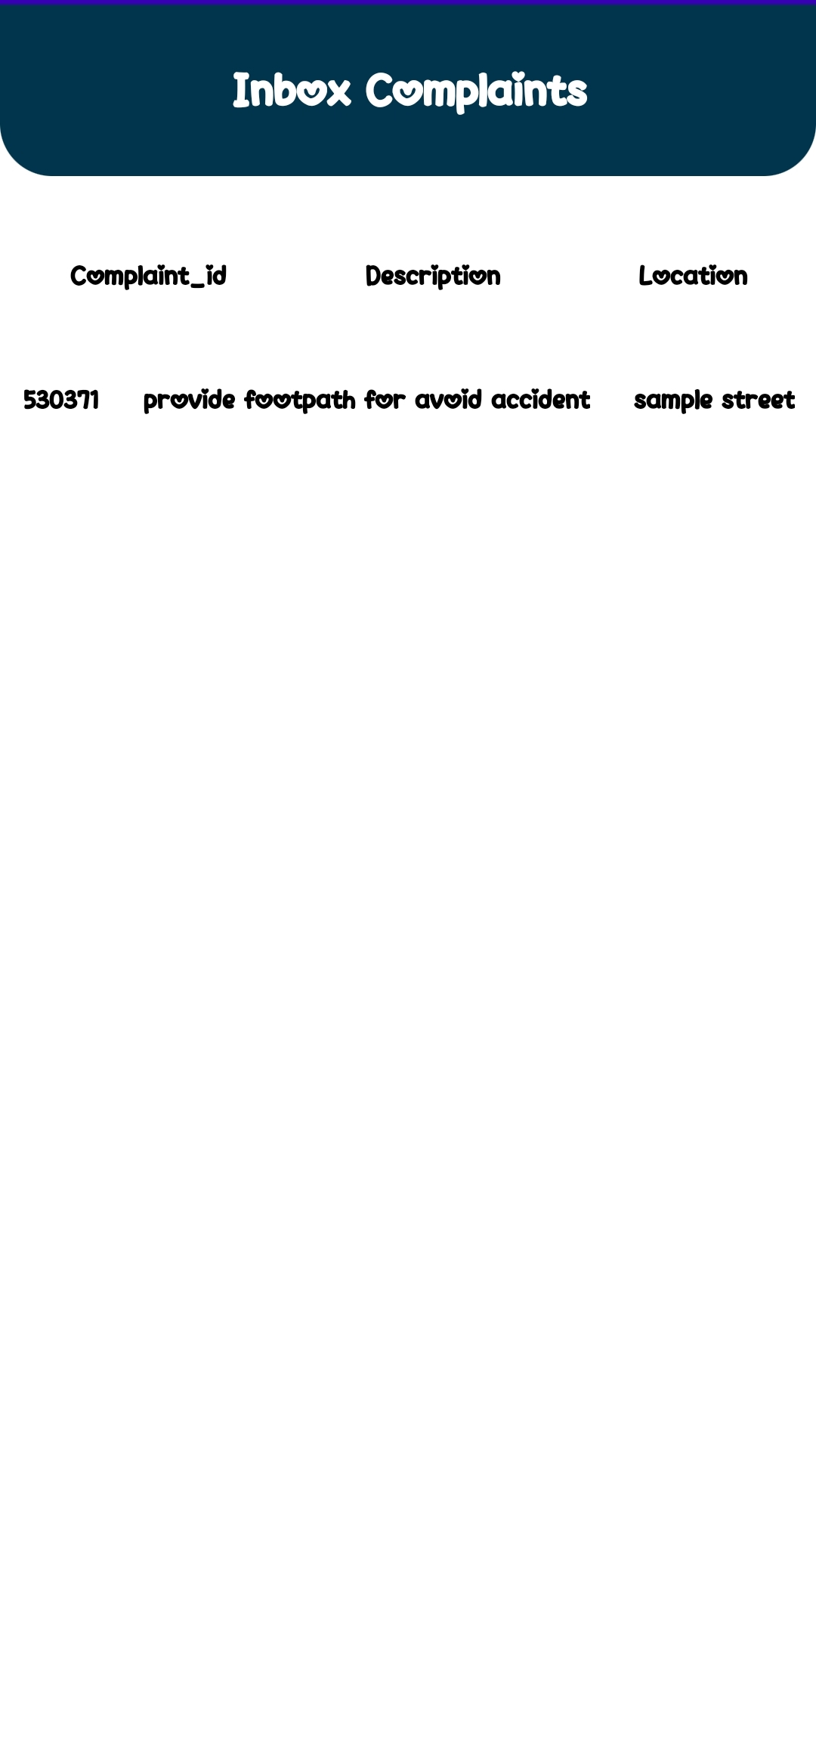
COMPLAINT (CREATE & INBOX)
<<create>>
<<inbox>>
OFFICER
PUBLIC
12

Slide 13
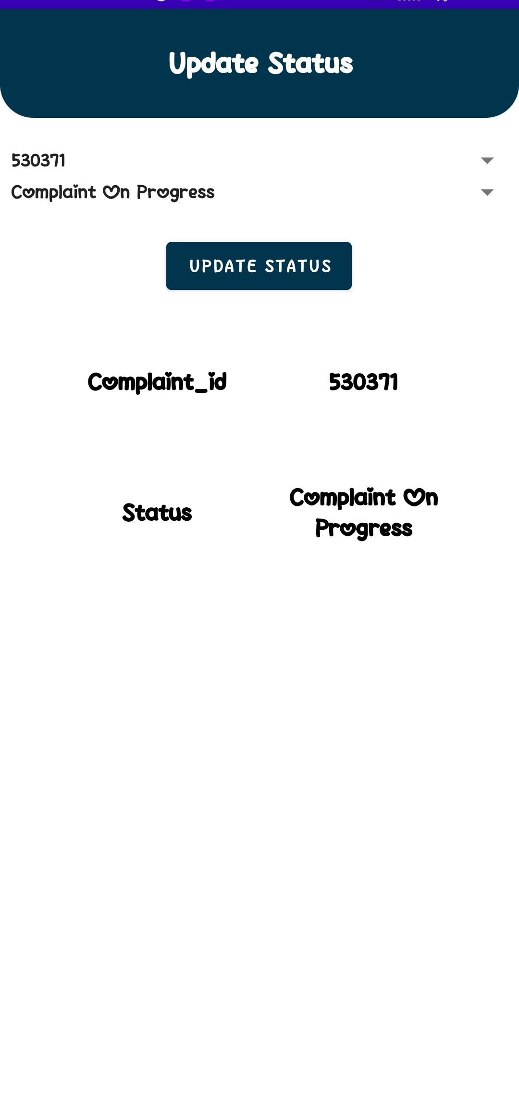
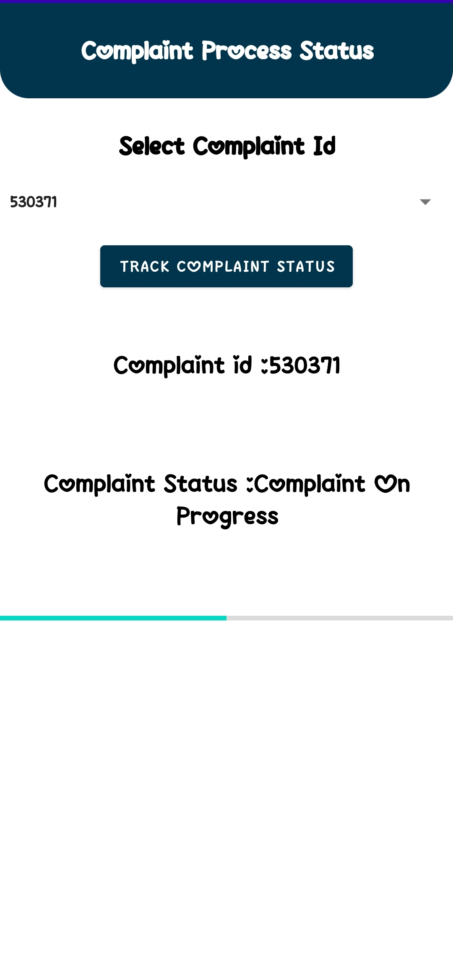
COMPLAINT (UPDATE & TRACK)
<<update>>
<<track>>
OFFICER
PUBLIC
13

Slide 14
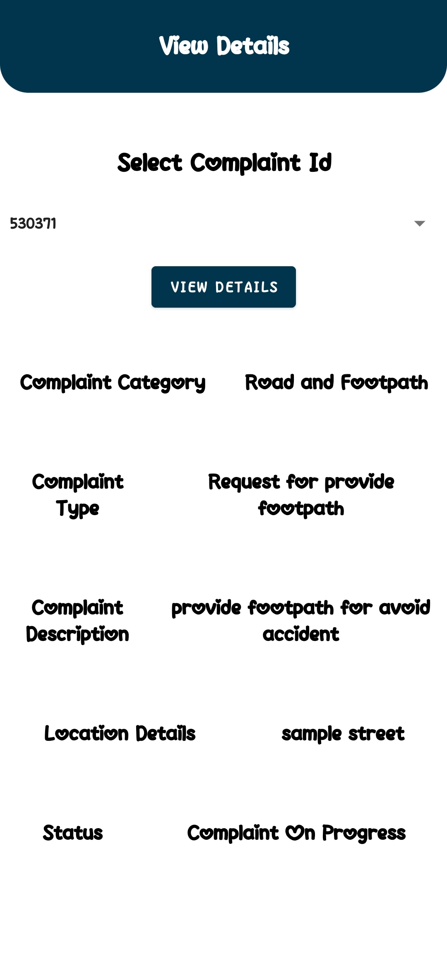
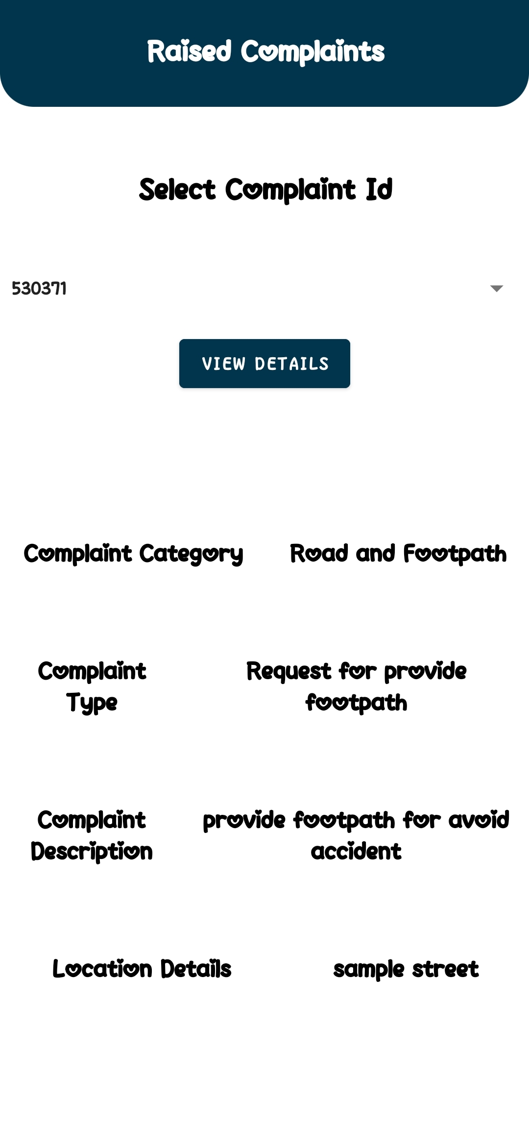
COMPLAINT (VIEW & RAISED)
<<view>>
<<raised>>
OFFICER
PUBLIC
14

Slide 15
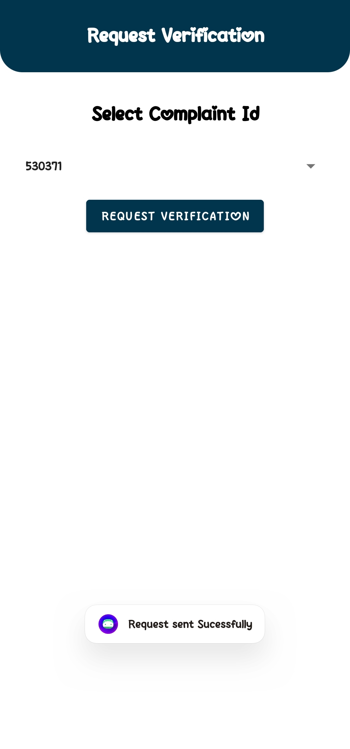
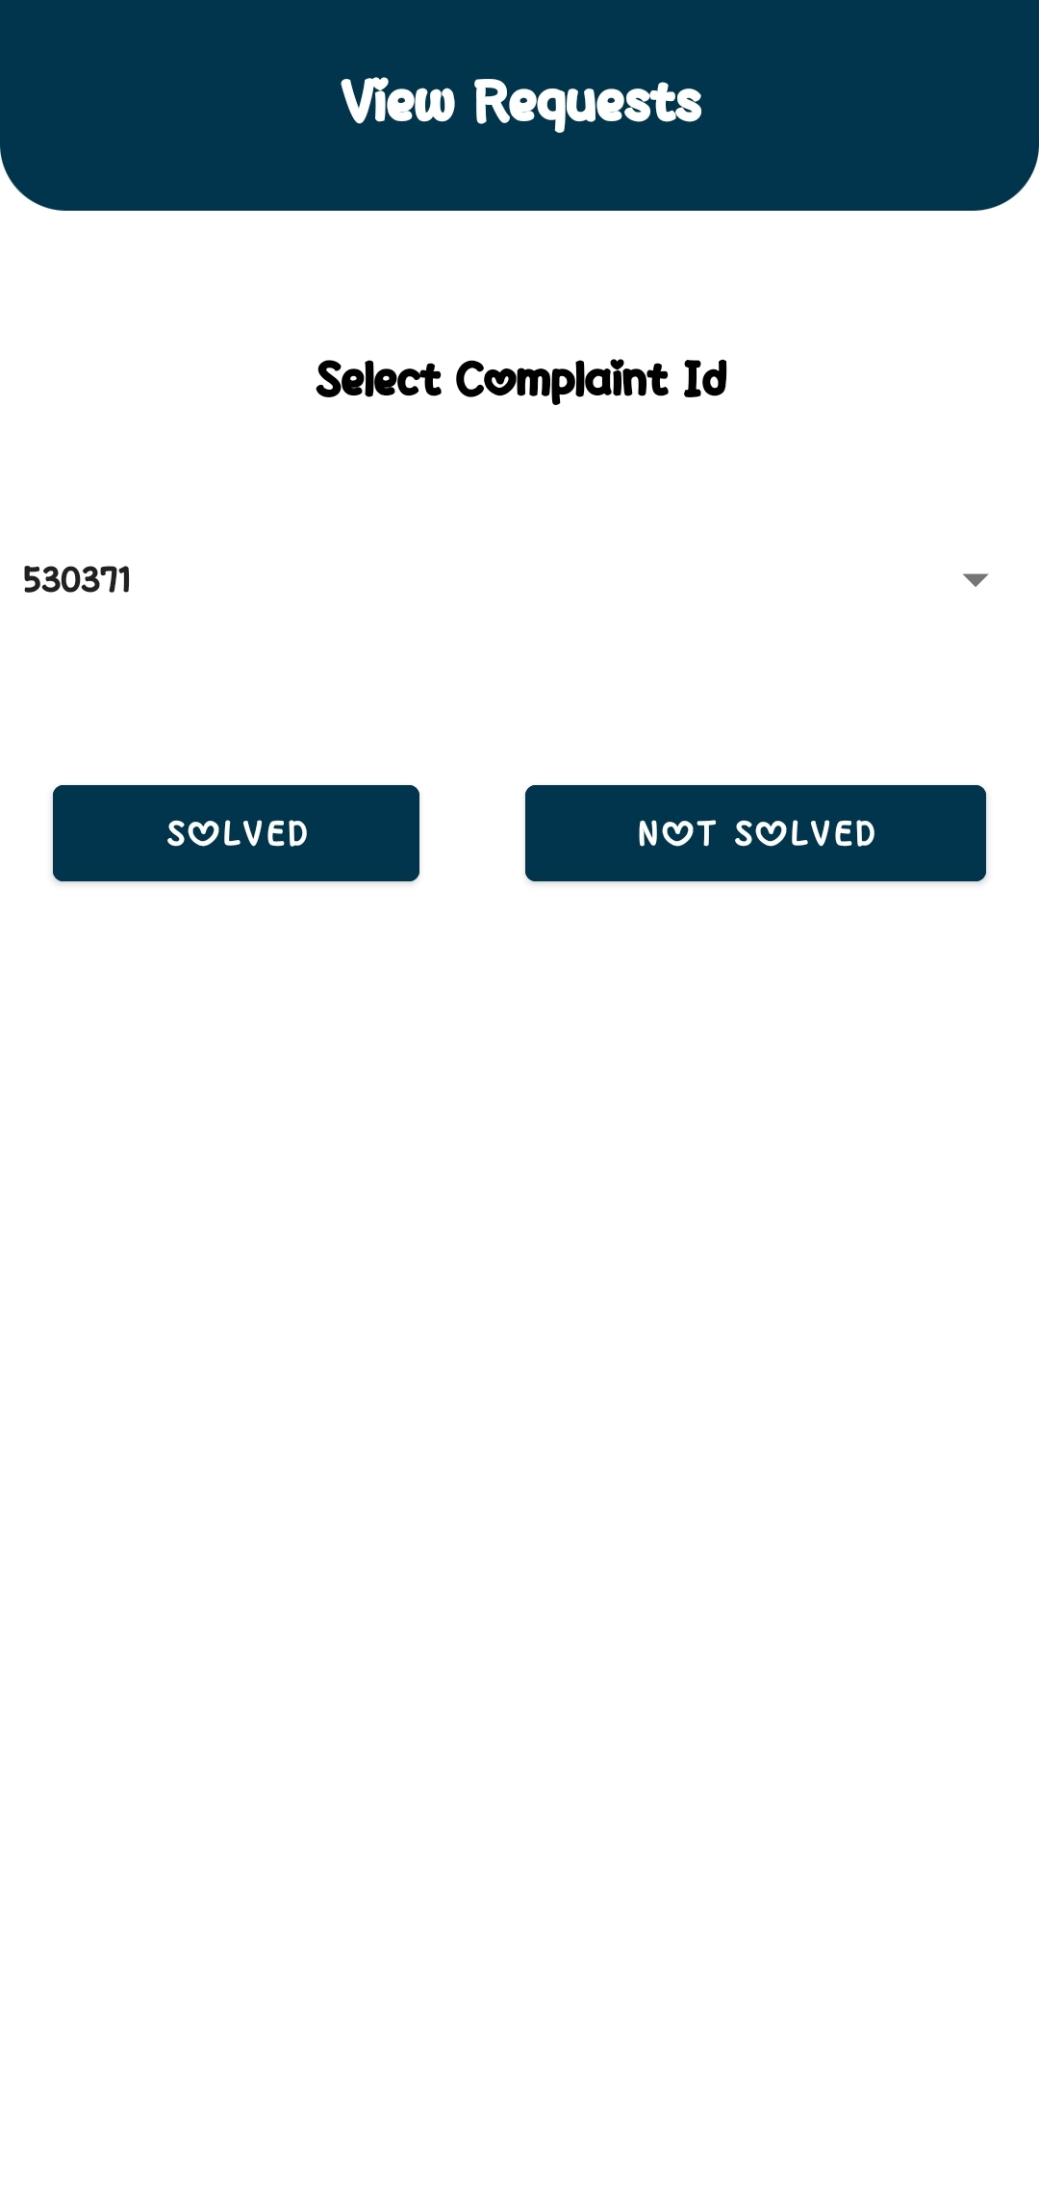
COMPLAINT (REQUEST)
<<request>>
<<view-requests>>
OFFICER
PUBLIC
15

Slide 16
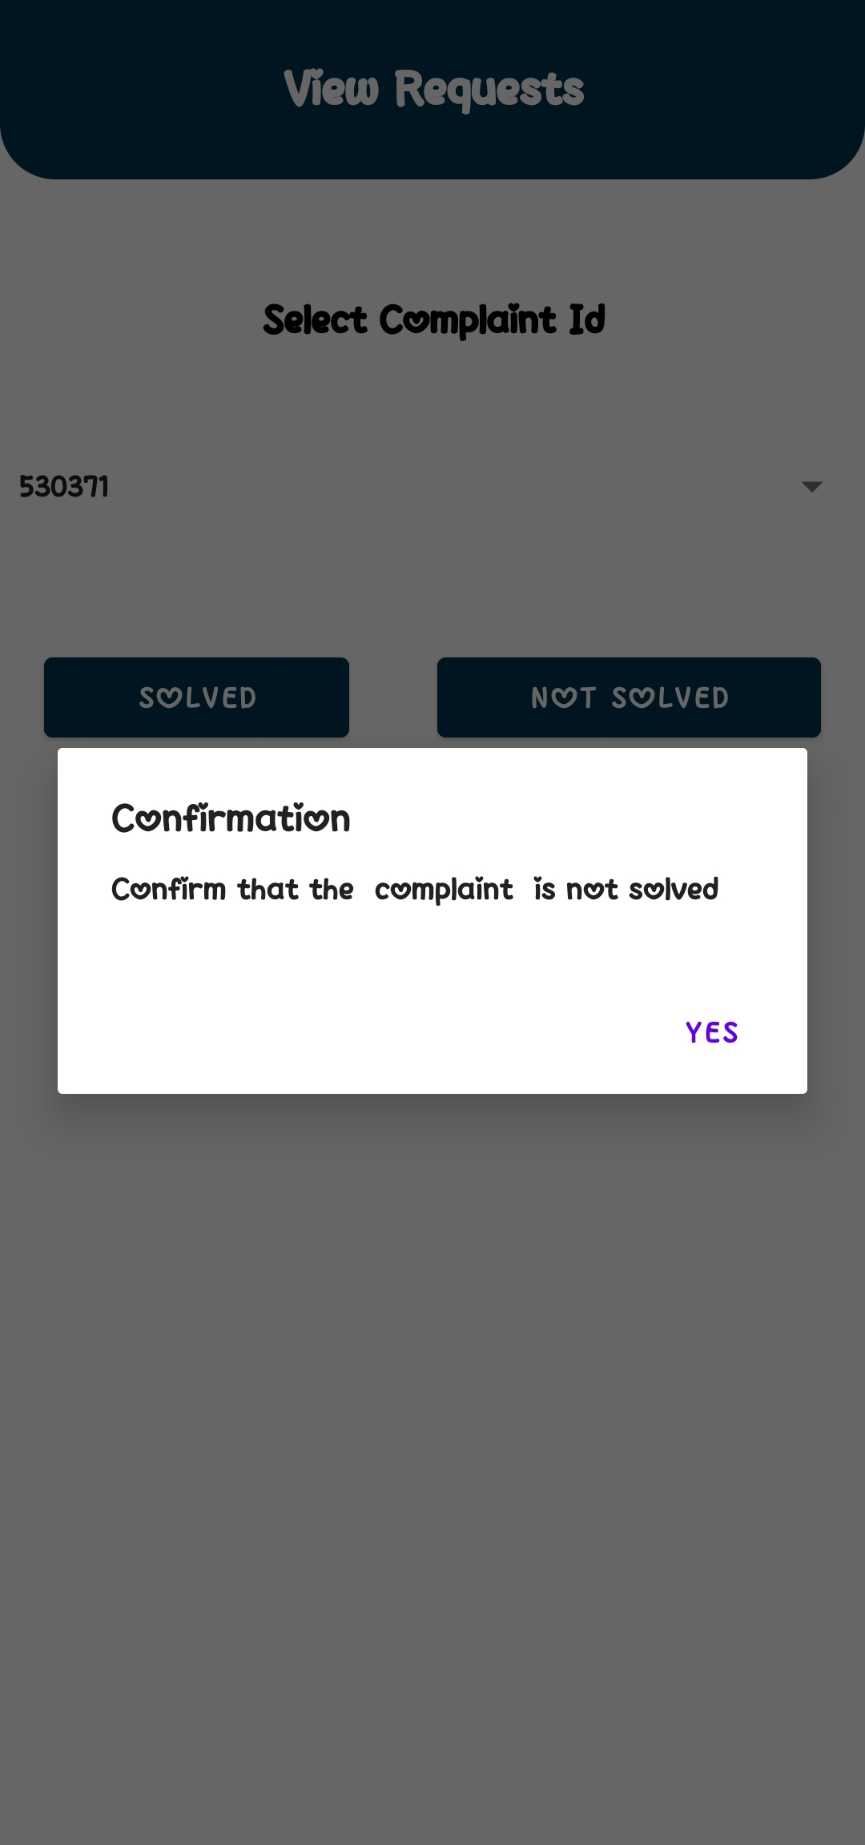
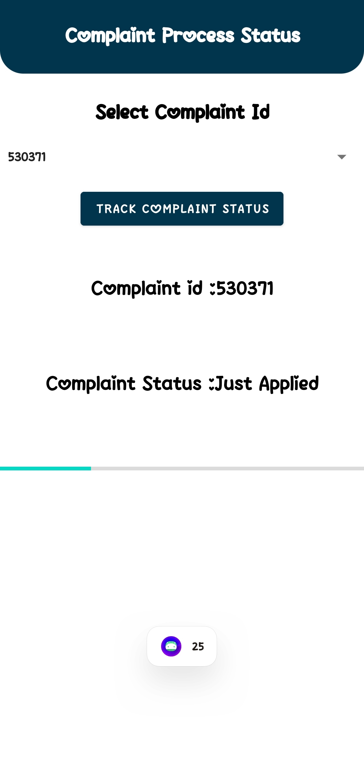
COMPLAINT (NOT SOLVED)
<<view-requests>>
<<status>>
<<not-solved>>
16

Slide 17
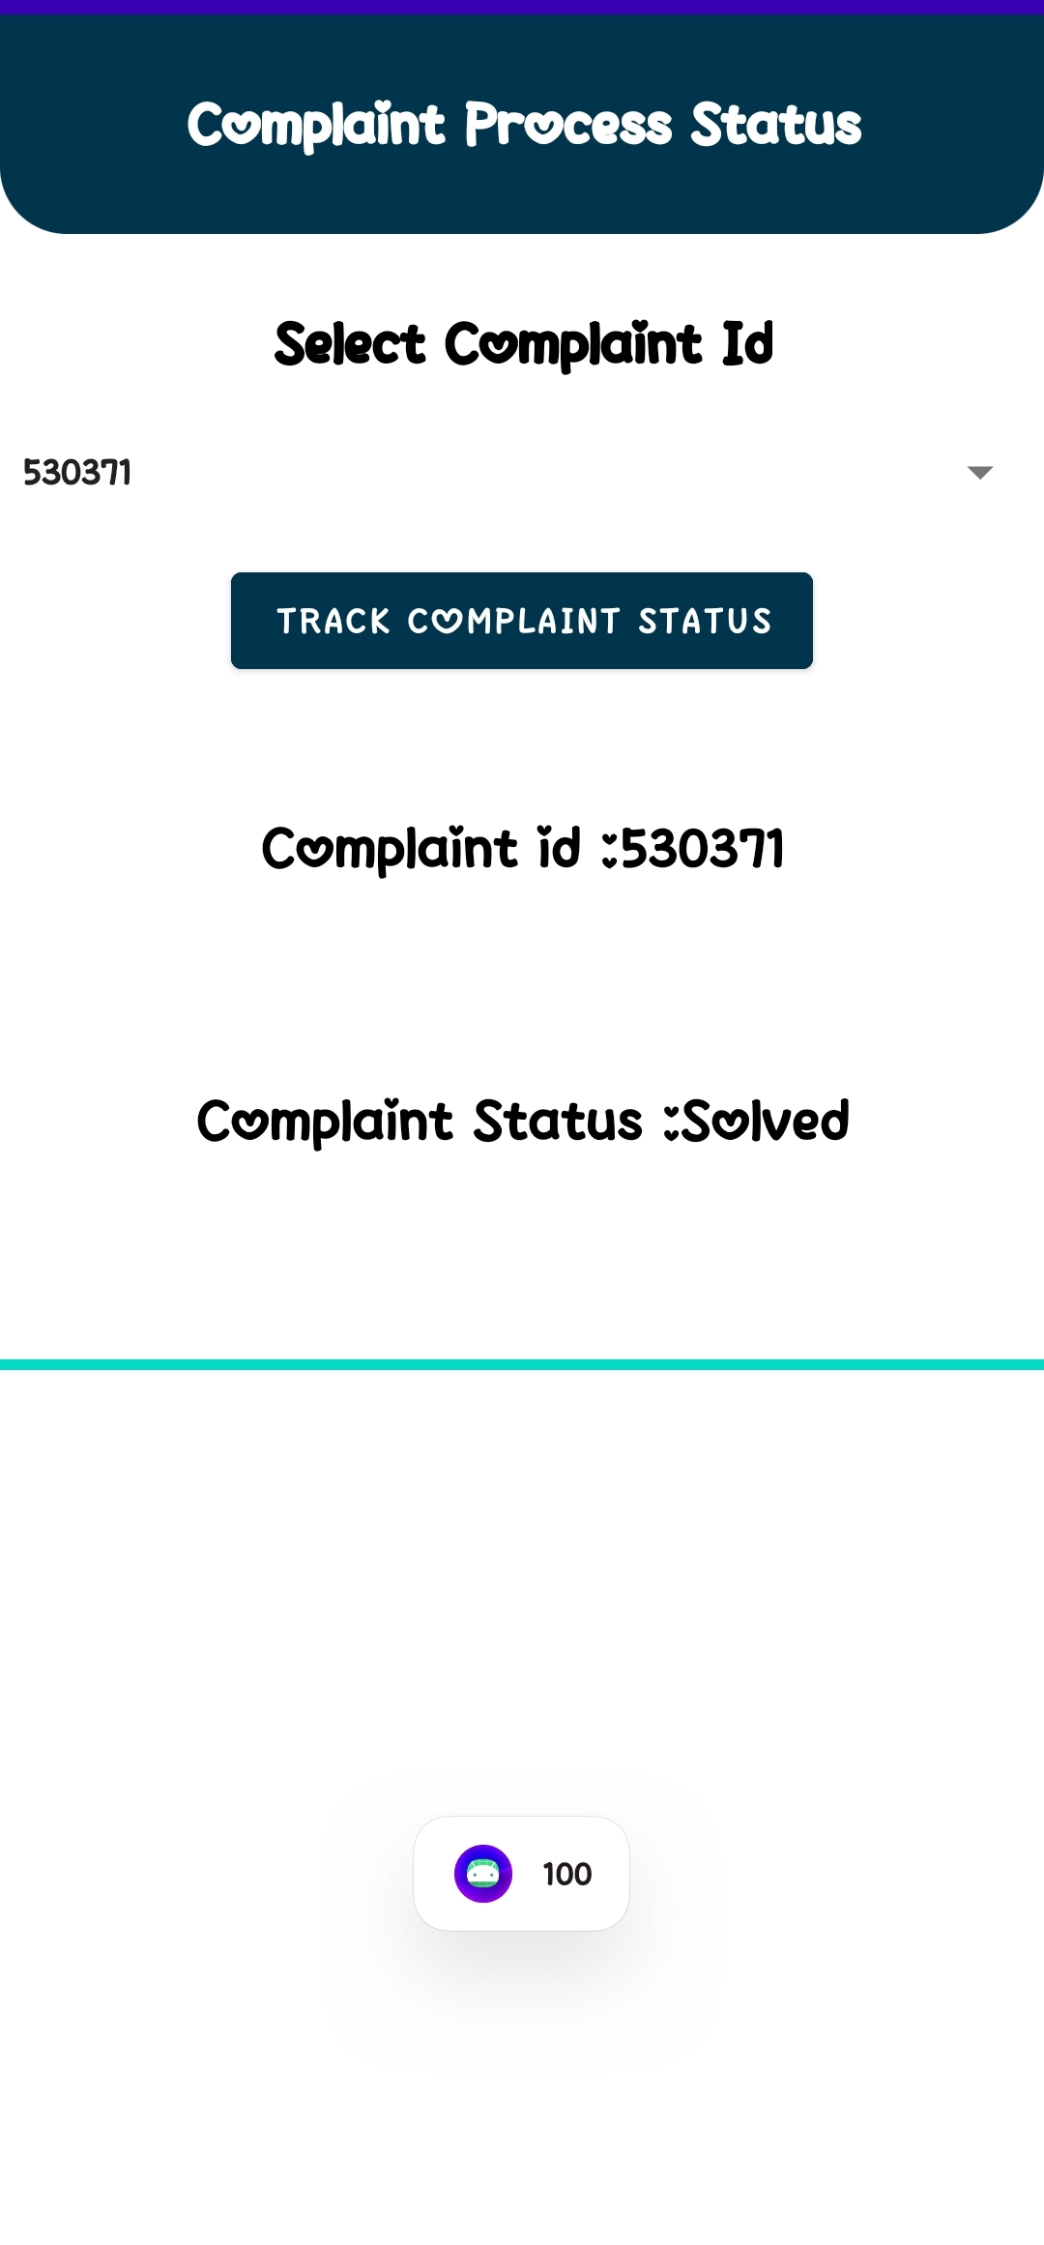

COMPLAINT (SOLVED)
<<view-requests>>
<<solved>>
<<status>>
17

Slide 18
DEMO LINK
https://drive.google.com/file/d/1TrEkn81sfCpoRSikUvm9bRf7rUtnMy8Z/view?usp=sharing
18

